Slide 1
ADVANCED FLOOD ALERT AND MONITORING SYSTEM USING IOT FOR REAL-TIME DISASTER MANAGEMENT

Slide 2
OBJECTIVES
The “Advanced Flood Alert and Monitoring System Using IoT for Real-Time Disaster Management” is a smart, low-cost solution designed to detect and respond to flood risks using ultrasonic and float sensors for continuous water level monitoring. It automatically triggers alerts through a buzzer, LED, and DC pump when unsafe levels or overflow are detected, while also sending real-time notifications via Pushover to remotely alert concerned individuals. The system logs environmental data to ThingSpeak for real-time and historical analysis and publishes alerts to an MQTT topic for broader IoT integration. Instead of GPS, it uses IP-based geolocation to include the location name in alerts, making it a practical solution for both urban and rural flood-prone areas.

Slide 3
01
NODE MCU [ESP32]
02
ULTRASONIC SENSOR
03
BREADBOARD
HARDWARE AND SOFTWARE
COMPONENTS
04
LED
05
FLOAT SENSOR
06
Arduino IDE
07
THINGSPEAK
08
PUSHOVER
09
MQTT

Slide 4
CONCEPTS INVOLVED
This project brings together several important technical concepts from IoT, electronics, and cloud computing. It uses IoT principles to connect sensors and communicate data to the internet in real time. Sensor integration plays a key role, with the ultrasonic sensor calculating water levels using sound wave reflection, and the float sensor acting as a switch to detect overflow. Wireless networking via WiFi enables cloud connectivity, while real-time alerts are triggered both locally and remotely using actuators and APIs. The system replaces GPS with IP-based geolocation for cost efficiency. MQTT is used for lightweight communication between devices, and ThingSpeak serves as the cloud-based platform for data visualization. These concepts combined result in a reliable and responsive flood monitoring system.

Slide 5
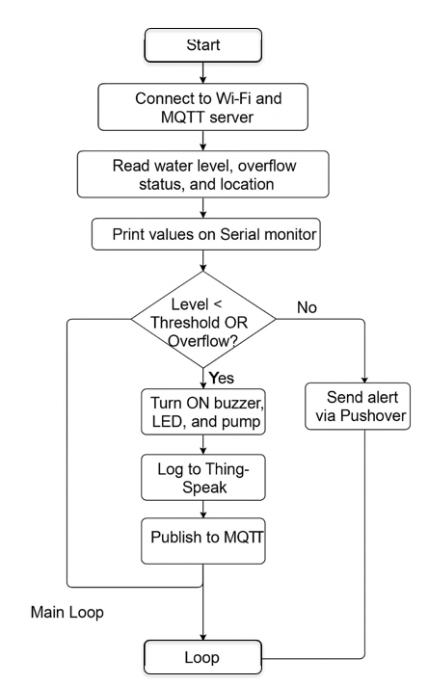
FLOWCHAT

Slide 6
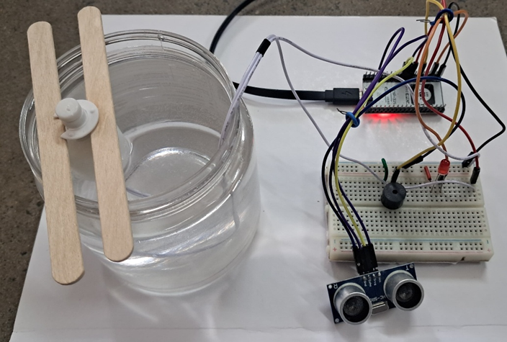
Project Setup
OUTPUT

Slide 7
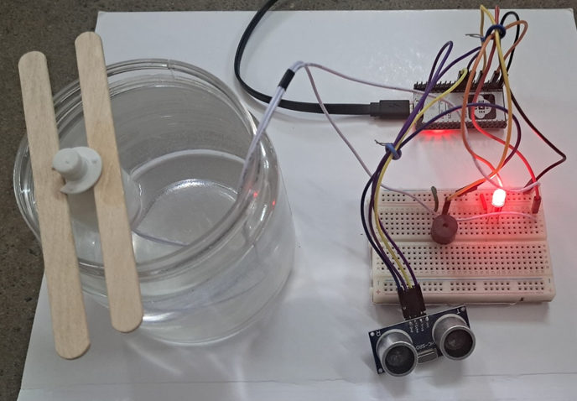
Alert Trigger Example:
OUTPUT

Slide 8
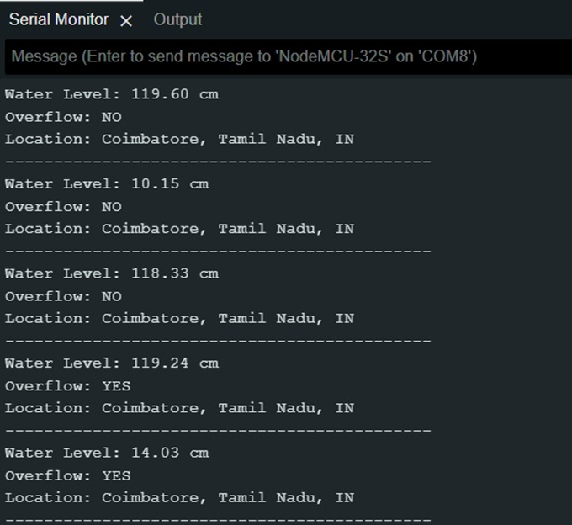
Serial Monitor Output
OUTPUT

Slide 9
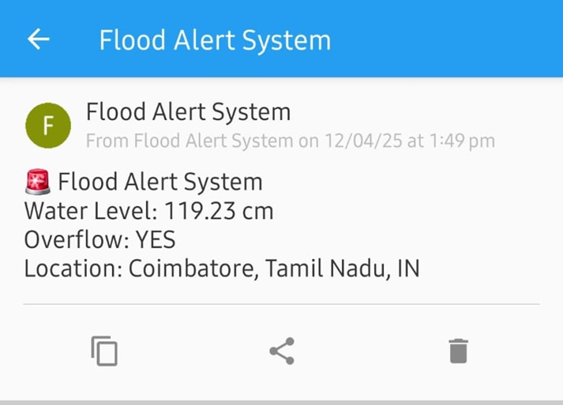
Mobile Push Notification via Pushover:
OUTPUT

Slide 10
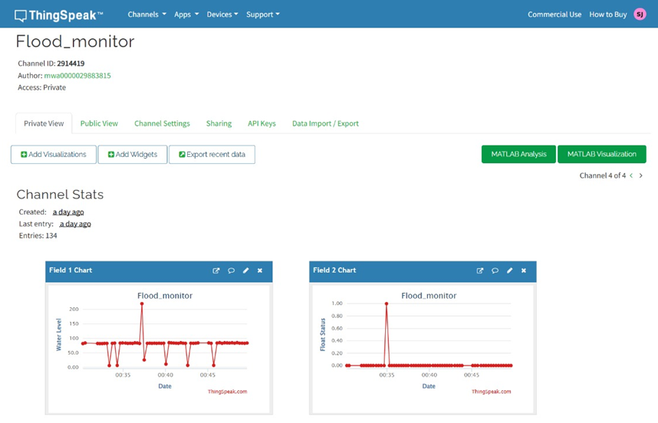
Real-Time Visualization Using ThingSpeak Dashboard
OUTPUT

Slide 11
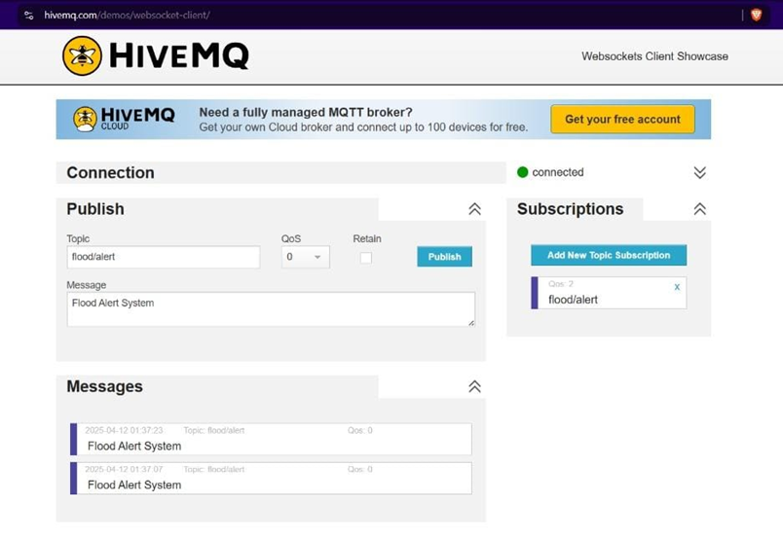
MQTT Message Published:
OUTPUT

Slide 12
CONCLUSION
The Advanced Flood Alert and Monitoring System Using IoT for Real-Time Disaster Management successfully demonstrates how modern technology can be utilized to tackle natural disasters like flooding through proactive monitoring and timely alerts. By combining sensor data, wireless communication, cloud integration, and real-time notifications, the system offers a comprehensive and scalable solution for flood detection. It not only provides immediate local and remote alerts but also enables data logging for future analysis and decision-making. The use of affordable components and open-source platforms ensures that the system is accessible and adaptable for deployment in various environments, including remote and under-resourced areas. Overall, this project highlights the potential of IoT in building smarter, safer, and more responsive disaster management systems.

Slide 13
THANK
YOU

